Slide 1
Postgres Indexes
Zach Croft
Postgres Internals Resource: https://www.interdb.jp/pg/index.html

Slide 2
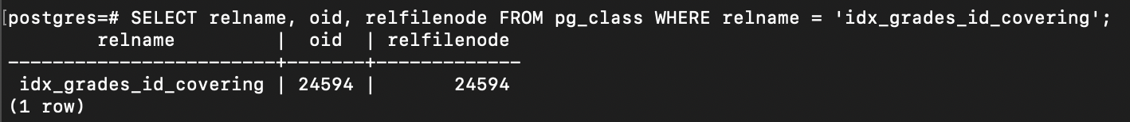
Index:
What, Why?
Data structure to enhance database performance.
  analogous to using binary search instead of linear search on a sorted list, or categorizing library books by sections but not one-by-one.
Supported index types: B-tree, Hash, GiST, SP-GiST, GIN, BRIN, and bloom.
  PG primary and secondary keys use indexes and default to B-tree.

Slide 3
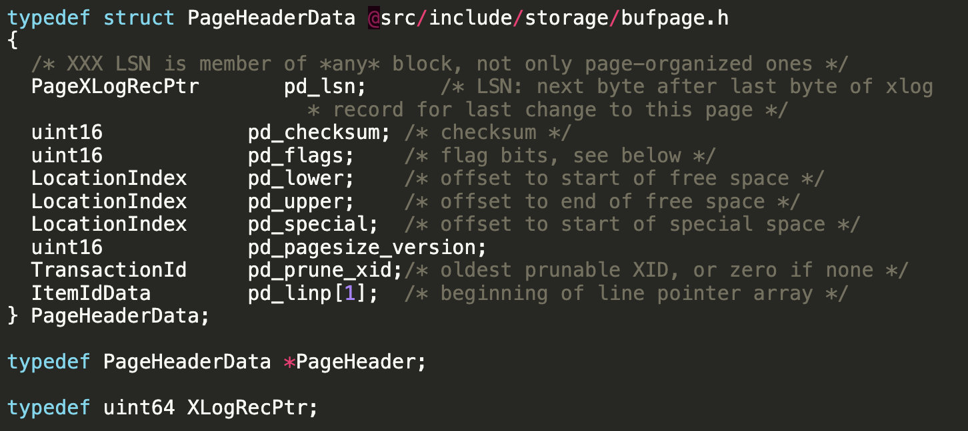
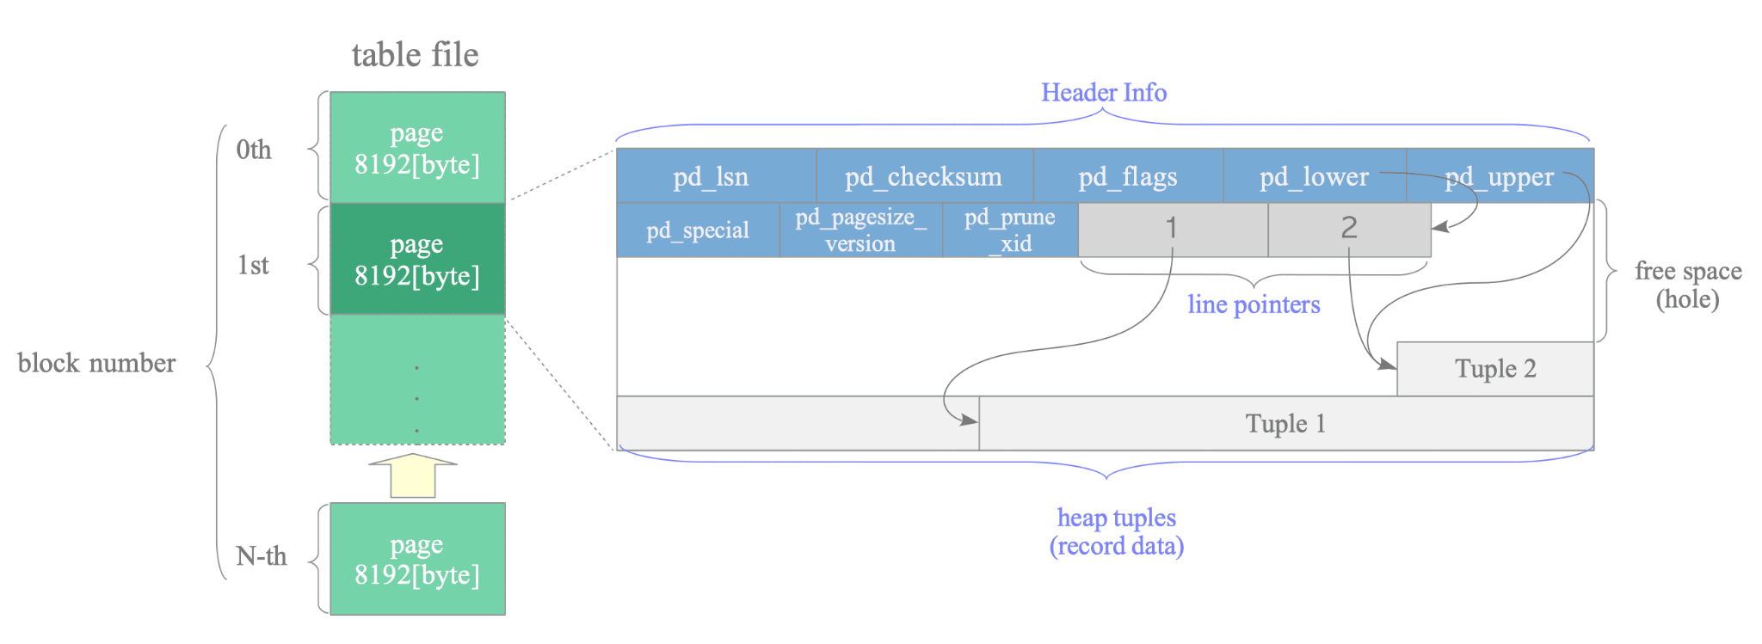
Heap and Pages
Data files (table, index, etc.) are divided into pages (or blocks) of a fixed default length of 8KB, each identified with a block number.
Tables are organized in a ‘heap’ structure (this is distinct from the heap tree structure AND the heap related to memory allocation).
Heap tables contain ‘pages’ (this is also distinct from the page related to memory allocation, those are typically 4KB) with header metadata, line pointer(s), free space, and heap tuple(s). A DB page could span 3 OS pages.
  Line pointers grow ‘up’ and heap tuples grow ‘down’ similar to heap and stack in memory.
Heap tuples store the actual records and are identified by a tuple identifier (TID) built from the block number and the offset number (line pointer ID).
  Line pointers are essentially mini-indexes within a page. Don’t confuse this with a PostgreSQL index.

Slide 4
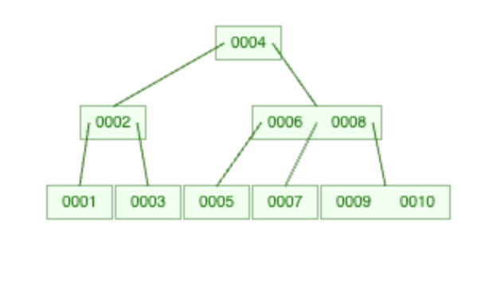
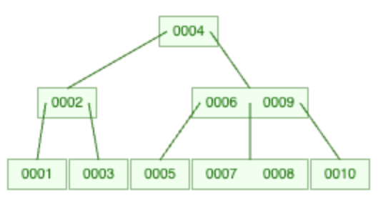
B-tree (Original)
Note: these images only show the key.
B-trees (bee trees) are balanced trees with pages as nodes.
  Each node contains elements, which are key-value pairs from key to TID.
    Postgres does not actually map to the primary key, which is not universal between different DB engines.
  If a node has m child nodes, then it can have at most m-1 elements.
(left) I added sequentially, (right) added in a different order.
  Ordering of the tree is dependent on input order.

Slide 5
B-tree Limitations
Storage
Performance: Range Query
All nodes (root, internal, leaf) have key-value pair elements (we will see, not necessary), taking more storage, therefore taller trees, and therefore more IO to disk (fetches more OS pages).
  Indexes may not entirely fit in memory if they are large–the database might have to use the swap which is slow.
Consider the above b-tree on id:
  SELECT id FROM grades WHERE id >= 1 AND id < 8;
  To get to id=1, fetches 3 pages.
    id=2 will probably be cached unless moved into swap.
  id=4 is probably cached.
  Id=5, fetches 2 pages.
  id=6 is probably cached.
    We got id=8 whether we wanted it or not–page IO fetches everything in it.

Slide 6
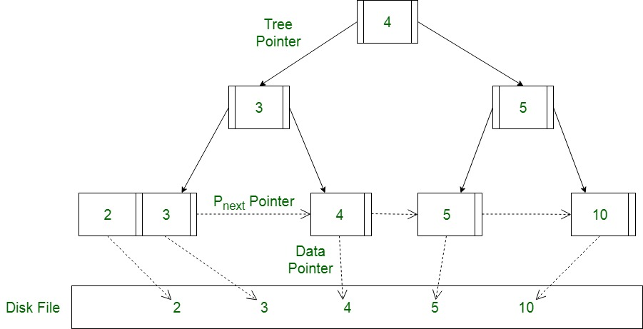
B+tree (Fancy)
Consequent nodes are doubly-linked which makes range queries much easier.
B+trees are balanced trees with pages as nodes, but:
  Internal nodes (everything except leaf nodes), are just keys.
    Nodes are pages; height is reduced and therefore traversal times are reduced.
Some keys are duplicated, and searches always go to the leaf nodes.
Postgres often operates by keeping all internal nodes in memory and then leaving the leaf nodes in the heap for quicker traversal.
Postgres really uses B+trees (modified) in all instances that there is a B-tree. B+trees are not always better as there are trade-offs, and also other indexes might be a better fit for situations.

Slide 7
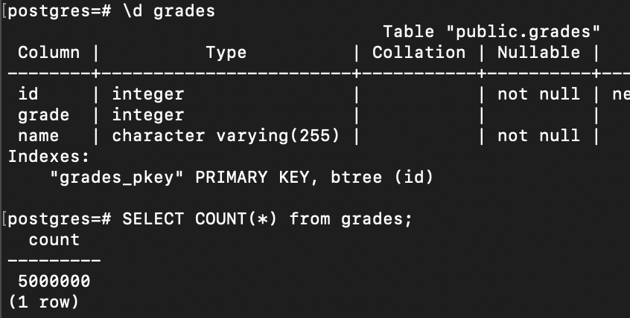

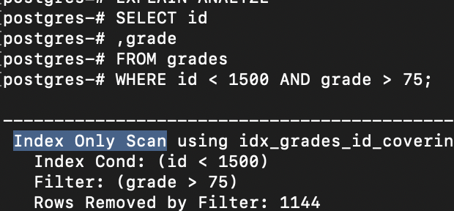
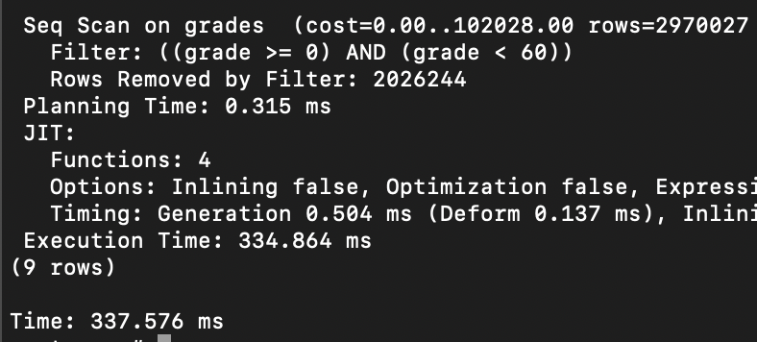
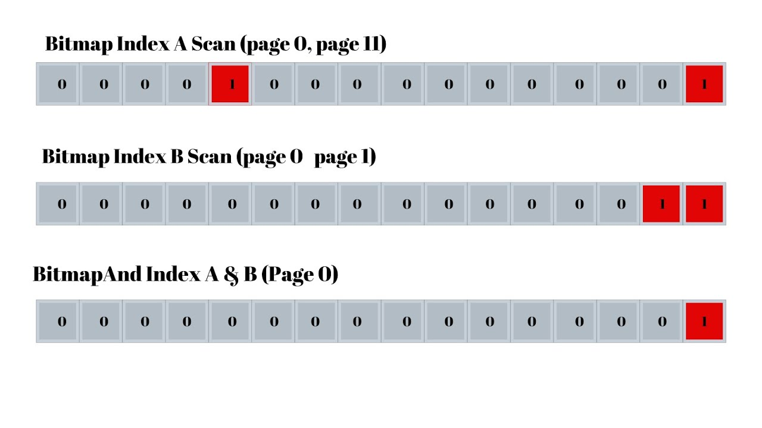
How Do Indexes Perform?
Table Scan
Index Scan
Index-Only Scan
Bitmap Index Scan
Generally, the slowest way queries can be made.
  DB engines often use multiple workers for speed.
  Buffer system and cache layers help.
A typical index scan where a key-value pair is found and then the corresponding heap table page is fetched.
SELECT * and SELECT name are same (row-based).
Never jump to the heap!
All requested values are in the index file.
Composite indexes (including other values in your index) work well here.
Works with bitmap heap scans to create a bitmap for heap pages to include.
BitmapAnd takes the intersection of multiple bitmaps.

Slide 8

Shopify
“In one high-throughput system at Shopify we’ve seen a 50 percent decrease in INSERT statement duration by switching from UUIDv4 to ULID for idempotency keys.”

Slide 9
Line Pointers (mini-indexes)
And Clustering
If I don’t really mind how long insertion takes, can I just sort the heap table pages and heap tuples on insertion and skip the IO’s from the index? Index-organized tables… are not in Postgres. But you can cluster periodically.
Demo!

Slide 10


Final Thoughts And Discussion
Indexes are generally useful but can slow down smaller queries, the planner takes note of this and may skip indexes.
Indexes help most on massive tables, but horizontal partitioning and/or sharding can help by splitting massive tables into smaller tables.
How do indexes work with locking and transactions?

